Slide 1
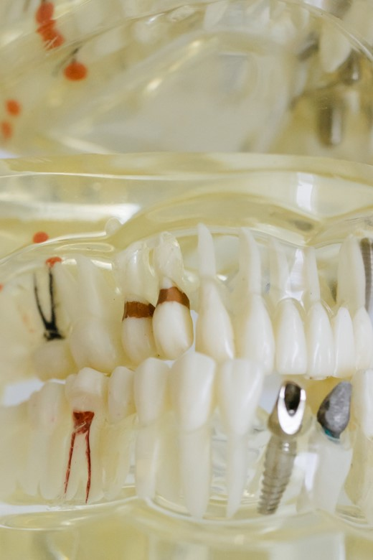
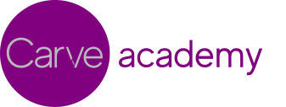
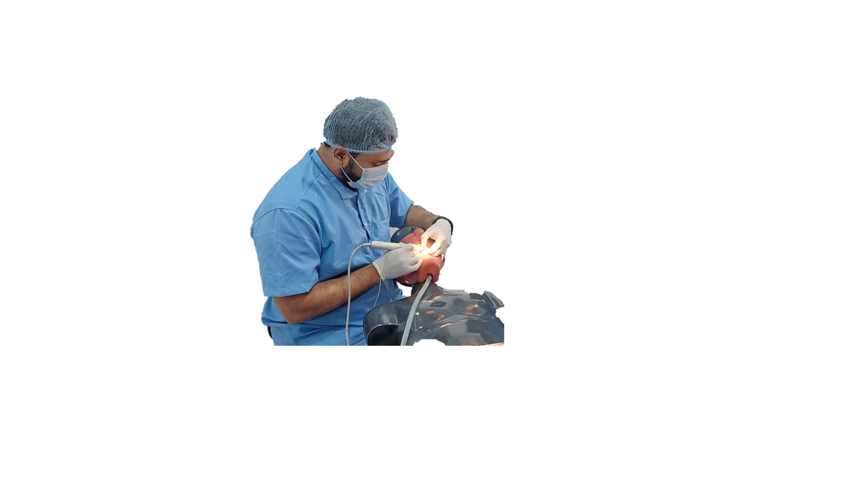


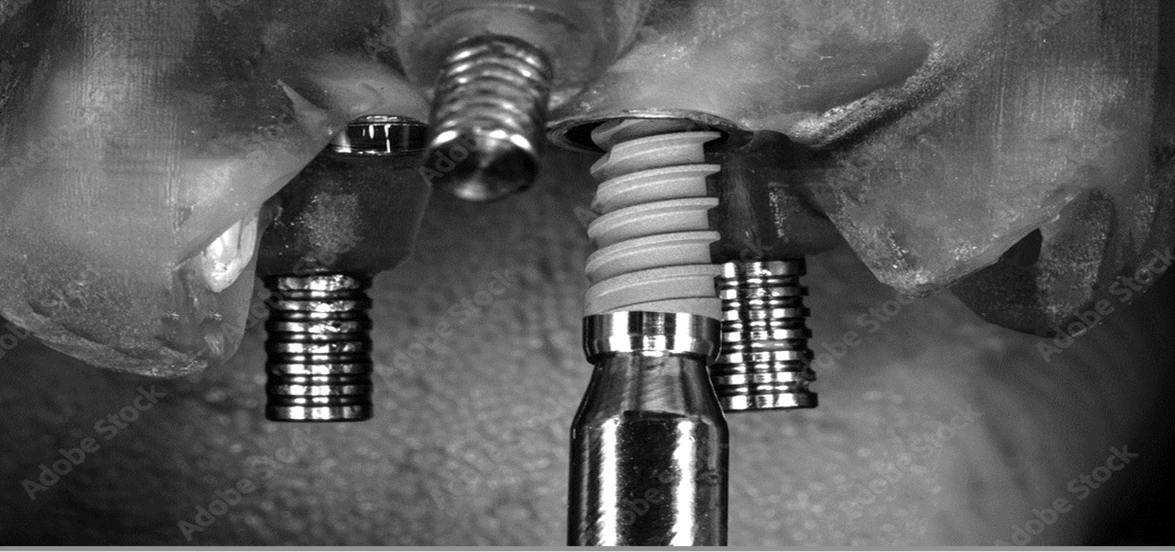







Introducing our flagship 2-day course in implant techniques
PRIME
Practice-based Implantology Essentials
#practice-based dentistry
Hands-on preclinical training on in-house real bone-like jaw models
Personalized setup and greater interaction with limited batch sizes
Extensive training in Suturing techniques on anatomically accurate pads
Detailed understanding of charging a patient for implant treatment
Registrations now
open for:
12-13 November 2022
(Sat –Sun)
To book your seat today, reach us at:
2 days | 9am–6pm
carve.blr@gmail.com
+91 7676 133 533 (Dr. Mudit)
+91 9844 155 371 (Dr. Bryan)
Carve Academy,
Bhuvaneswari Nagar, Near Esteem Mall, Hebbal Kempapura, Bangalore
Or visit us at:
www.carveacademy.in

Slide 2
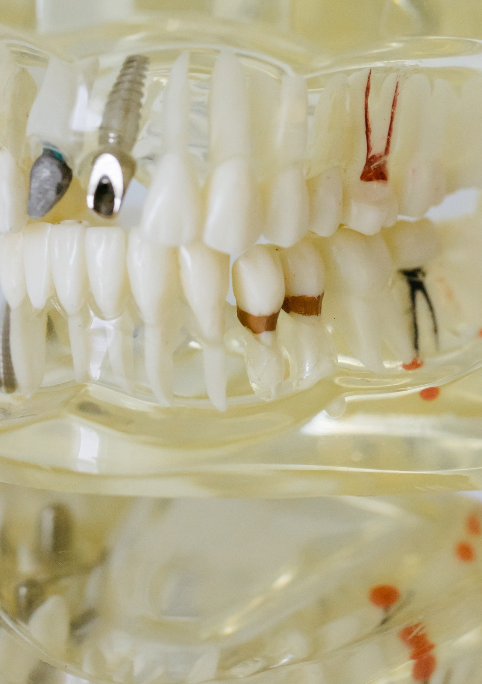
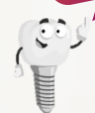






Contact us for Early Bird
Discount
Batch size limited to
8
participants
+91 9019043026
(Carve Academy)
With PRIME, you will be able to:
Get hands-on training on impression techniques and a variety of prosthetic solutions
Learn comprehensive implant case planning, with OPG-tracing and CBCT-reading
Receive expert guidance throughout your implant journey
Registrations on a
first come,
first served basis
Take home an implant, with the option to place it in your patient under expert supervision
Upskill yourself and start placing implants in your practice immediately
Become a
Certified Implantologist

Slide 3
Course itinerary
10.00 – 10.30
Introduction to course
10.30 – 11.00
How to convince patient and Case selection
11.00 – 11.30
Parts of implant and Bone density
11.30 – 12.00
Pre-Implant investigations and Tracing
DAY 1
12.00 – 12.30
Demonstration of armamentarium
Surgical
12.30 – 1.30
Lunch
1.30 – 3.30
HANDS-ON: Implant placement + Flap and Suturing
3.30 – 4.00
Break (with refreshments)
4.00 – 6.00
HANDS-ON: Implant placement + Flap and Suturing
6.00 – 6.30
Learnings of the day and Briefing for Day 2
10.00 – 10.30
Introduction to implant prosthetic components
10.30 – 11.30
2nd stage surgery, Abutment selection
11.30 – 1.30
HANDS-ON: Impression techniques + Final prosthesis
1.30 – 2.30
Lunch
DAY 2
2.30 – 3.30
Implant Failures and Management
Prosthetic
3.30 – 4.30
HANDS-ON: Grafting techniques + Membrane placement
4.30 – 5.00
Break (with refreshments)
5.00 – 5.30
Charging a patient & Cost calculator demo
5.30 – 6.00
Q&A
6.00 onw.
Certificate distribution and feedback

Slide 4

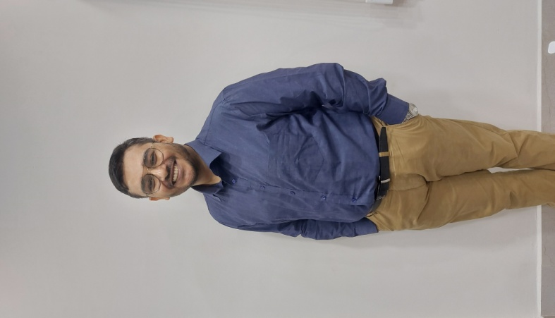
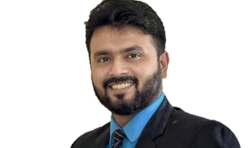
coaches
Coordinators of the course
Dr. Mudit Kumar
Periodontist, Implantologist and LASER Specialist
Holding a Bachelor’s degree from Bharati Vidyapeeth Dental College (Pune) and a Master’s degree in Periodontology and LASER Dentistry from JSS Dental College (Mysuru), Dr. Mudit Kumar is a seasoned expert in all types of gum diseases, along with extensive experience in conventional and basal implantology.
He is one of the recipients of the prestigious ICMR Grant for conducting research on Socket Shield technique in implants. In addition to operating a high-growth practice, he is one of the few dental surgeons in Bangalore to specialize in LASER dentistry. Dr. Mudit has also garnered numerous accolades such as the Dr. V.N. Bhatavadekar Award from the Indian Society of Periodontology (ISP), of which he is a lifetime member.
.
Dr. Bryan D Menezes
Dental Surgeon and Implantologist
Having secured his bachelor’s degree from Government Dental College & Research Institute Bangalore, Dr. Bryan Menezes later specialized in Dental Implantology. He has numerous certifications from prestigious institutes such as the American Academy of General Dentistry (New Jersey).
He established his clinical practice - Smile IsleTM Dental Care - in 2012 in Bangalore, starting as a humble single chair setup. Today, Smile IsleTM is among the top 5 preferred dental care centres in Bangalore North for local as well as international patients (as per aggregator platforms), with in-house Soft Tissue Lasers, a Pediatric Sedation unit and several latest radiographic facilities.

